Slide 1

Business Introduction
At CoreTech Labs ,we are at the forefront of cutting edge solutions specializing in software development, AI integration, and data-driven innovations.
Our Mission: To empower businesses with scalable, intelligent, and efficient digital solutions that drive growth and operational excellence.

Slide 2
CoreTech Labs provides the following services
Software Development-Tailored solutions for web, mobile, and enterprise applications.
AI & Machine Learning-Smart automation and predictable insights.
Data Analytics & Business Intelligence- Turning data into actionable decisions.

Slide 3
ROAD ACCIDENT ANALYSIS
Road accident remain a critical public safety concern, with multiple factors such as weather conditions, road surface conditions, speed limits, and traffic controls influencing accident severity.

Slide 4
Project Rationale
Importance of Analyzing Road Traffic Accidents.
Need for Data-Driven Decision Making.
Addressing Key Road Safety Challenges.
Enhanced Road Safety Policies.
Optimized Resource Allocation.

Slide 5
Project Workflow
Data Cleaning
Charts Creation
Dashboard Development (Excel)

Slide 6
Questions the Data can Answer
Trend of Accidents by Year, Month, and Day of the week, and the Severity of Accidents.
High-Risk Factors Contributing to Accidents- Speed Limits, Road Conditions, Weather Conditions, Light Conditions, Time of Day, Urban vs Rural Areas.
Accident Hotspots For Traffic Safety Interventions.
Recommendations.

Slide 7
RESULTS
 | Number of Casualties | Number of Vehicle | Speed limit | Latitude | Longitude
Mean | 1 | 2 | 39 | 52.487001 | -1.368882
Median | 1 | 2 | 30 | 52.225935 | -1.349254
Mode | 1 | 2 | 30 | 52.458798 | -1.190861
Skewness | 5.685365237 | 1.853603433 | 1.14211987 | 0.999366 | -0.378502
Q3 | 2 | 2 | 60 | 53.415514 | -0.206810
Q1 | 1 | 1 | 30 | 51.485248 | -2.247942
Range | 1 | 1 | 30 | 1.930266 | 2.041132
Variance | 0.665624293 | 0.50477643 | 196.923451 | 1.792951 | 1.8389894
Standard Deviation | 0.82 | 0.71 | 14 | 1.34 | 1.36
The mean number of casualties is 1, while the median is 1. This tells us that most accidents involve only one casualty, but there are some higher-casualty incidents pulling the mean upward. The high skewness confirms this distribution is right-skewed.
The mean number of vehicles is 2, with a median of 2. This indicates most accidents involve two vehicles, which aligns with typical collision patterns.
The median speed limit is 30 mph, and the range is 30 mph. This shows that accidents happen across all speed environments, but predominantly in urban 30 mph zones.
These descriptive statistics help us understand the structure and distribution of the dataset before analyzing causation.
The Mean, Range and Standard Deviation of the Latitude and Longitude indicate that road accidents are spatially distributed across multiple local authorities, rather than being limited to a specific center.

Slide 8
ACCIDENT DETERMINANTS
85.19% of accidents are slight, 13.19% are serious, 1.62% are fatal.
This indicates that while accidents are frequent, most are slight severity.
However, even a small percentage of fatal accidents is significant, this represents thousands of lives affected.
This distinction is important because policy should focus not just on reducing accidents, but on reducing severity.
From the results, 2021 recorded a higher number of road accidents than 2022, accounting for approximately 53.11% of the total accidents, while 2022 accounted for about 46.89%.
This indicates a decrease of 19,134 accidents from 2021 to 2022.
There is a slight decrease in accidents from 2021 to 2022. This could be due to post-pandemic traffic changes, improved enforcement, and behavioral shifts.

Slide 9
Cars account for 78% of casualties. This is expected because cars dominate road usage.
However, motorcycles, while lower in frequency, tend to have higher severity proportions.
This suggests targeted motorcycle safety policies could reduce serious injuries.

Slide 10
From the analysis, accidents are not evenly distributed across the four time periods. The results show that Afternoon and Evening periods account for the highest number of accidents, while Night has the lowest frequency.
The higher number of accidents during the Afternoon period can be largely attributed to peak traffic conditions, particularly during the time when people are leaving work, schools, and other daily activities. During this period, traffic congestion increases significantly, which raises the likelihood of vehicle interactions and collisions.
Similarly, the Evening period also shows a relatively high number of accidents. This may be influenced by several factors such as reduced visibility, driver fatigue after long working hours, and increased social or recreational travel.
The Morning period shows a moderate number of accidents, which corresponds with the morning commute when many people are traveling to work and school. Although traffic is heavy, drivers may be more alert compared to later in the day.
The Night period records the lowest number of accidents, primarily due to reduced traffic volume. However, accidents occurring at night may still be more severe due to factors such as reduced visibility, fatigue, or impaired driving.
Overall, the results suggest that traffic density and daily commuting patterns strongly influence accident occurrence throughout the day.

Slide 11
Most accidents occur on dry roads.
However, this is because most driving happens under dry conditions.
Also, wet, icy, and snowy conditions increase severity risk.
This indicates that weather does not necessarily increase frequency dramatically, but it increases impact severity.
Fine weather accounts for most accidents.
However, adverse weather conditions such as rain, fog, and snow show higher fatal ratios relative to total occurrences.
This implies that environmental awareness campaigns could reduce severe outcomes.

Slide 12
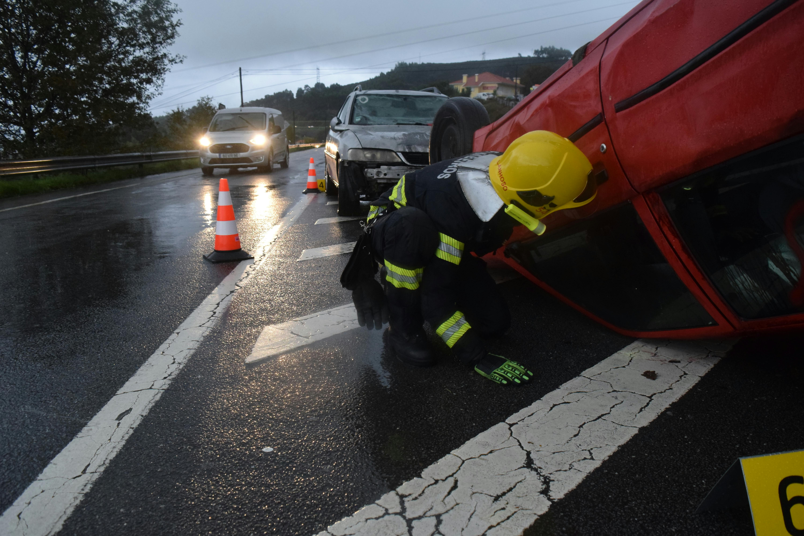
30 mph zones show the highest number of accidents.
This reflects urban congestion and higher traffic density.
However, when we look at severity proportions, higher speed zones (60–70 mph) show relatively higher fatal outcomes.
This demonstrates an important distinction:
Urban roads → more frequent collisions High-speed roads → more severe consequences
This supports the argument for:
Urban traffic calming
Rural speed enforcement

Slide 13
Daylight has the highest accident count.
But fatal accidents are proportionally higher during darkness.
Possible reasons:
Reduced visibility
Fatigue
Night-time speeding
This supports improved street lighting and nighttime enforcement.
Single carriageways dominate accident counts primarily because they are the most common type of road infrastructure, especially in both urban and rural areas.
However, roundabouts typically show lower severity levels because their design forces vehicles to slow down.
This suggests that road design plays a critical role in accident prevention, and infrastructure improvements such as roundabouts or controlled intersections can reduce accident severity.

Slide 14
This is one of the most important findings.
Urban areas have more total accidents.
However, rural areas have a higher fatality proportion.
This suggests:
Higher speeds in rural areas,
Slower emergency response times,
Less infrastructure control.
Therefore, rural road safety improvements could significantly reduce fatality rates.

Slide 15
This indicates that junctions without strict traffic control mechanisms are associated with higher accident frequency.
Uncontrolled intersections increase the likelihood of:
Driver misjudgment
Failure to yield
Collision conflicts
This highlights the importance of traffic signals, stop signs, and controlled intersection design in improving road safety.
The fact that many accidents occur outside junctions suggests that factors such as:
Speed
Driver distraction
Overtaking behavior
play a significant role.
However, T-junctions and crossroads also show substantial accident counts, which indicates that intersection design remains a major risk factor.
Improving visibility, signage, and traffic control at junctions could reduce these accidents.

Slide 16
HOTSPOTS & HEAT MAP ANALYSIS
Junction Control | Accident_Severity
Authorised person | 460
Auto traffic signal | 32349
Data missing or out of range | 98055
Give way or uncontrolled | 150045
Not at junction or within 20 metres | 25378
Stop sign | 1685
Grand Total | 307972
Junction Detail | Accident_Severity
Crossroads | 29948
Not at junction or within 20 metres | 123093
Private drive or entrance | 10875
Roundabout | 27264
T or staggered junction | 96718
 | Fatal | Serious | Slight | Total
Morning | 1213 | 10116 | 74549 | 85878
Afternoon | 1791 | 16752 | 113854 | 132397
Evening | 1322 | 10508 | 60475 | 72305
Night | 668 | 3238 | 13486 | 17392
 |  |  |  | 307972

Slide 17
HOTSPOTS & HEAT MAP ANALYSIS
Local Authority (Top 10) | Fatal | Serious | Slight | Total Accidents
Birmingham | 57 | 706 | 5402 | 6165
Leeds | 38 | 531 | 3571 | 4140
Manchester | 24 | 313 | 2795 | 3132
Bradford | 30 | 357 | 2619 | 3006
Westminster | 189 | 387 | 2235 | 2811
Sheffield | 16 | 325 | 2409 | 2750
Liverpool | 22 | 373 | 2216 | 2611
Cornwall | 43 | 255 | 2308 | 2606
Barnet | 17 | 230 | 2055 | 2302
City of Bristol | 17 | 211 | 2042 | 2270
Light Condition | Fatal | Serious | Slight | Total
Daylight | 2898 | 28589 | 195798 | 227285
Darkness - lights lit | 1252 | 8470 | 50371 | 60093
Darkness - no lighting | 774 | 3057 | 12697 | 16528
Darkness - lights unlit | 19 | 145 | 978 | 1142
Darkness - lighting unknown | 51 | 353 | 2520 | 2924

Slide 18
RECOMMENDATIONS FOR ROAD SAFETY IMPROVEMENTS
1. Target High-Risk Hotspots Identified from Heat Maps
Local authorities should prioritize road safety interventions in geographic accident hotspots identified through the heat map analysis.
The latitude and longitude analysis revealed clusters of accidents occurring repeatedly in specific areas. These hotspots indicate locations where environmental or infrastructure factors are contributing to frequent accidents.
Possible Actions
Install traffic cameras
Add speed control measures
Improve road markings and signage
Implement traffic calming measures such as speed bumps.
Targeted interventions in hotspots can significantly reduce accident frequency and improve overall road safety.
2. Improve Lighting in High-Risk Nighttime Areas
Increase street lighting and visibility infrastructure in areas where accidents occur during darkness.
Although most accidents occur during daylight due to higher traffic volumes, the analysis showed that nighttime accidents tend to have higher severity levels.
Limited visibility increases the likelihood of serious or fatal accidents.
Possible Actions
Install additional street lights
Improve reflective road signs
Use reflective lane markings
Add illuminated pedestrian crossings
Improved visibility will help drivers detect hazards earlier, reducing severe nighttime accidents.

Slide 19
3. Strengthen Safety Measures on High-Speed Roads
Implement stricter speed management policies on roads with speed limits of 60–70 mph, where accident severity tends to be higher. While most accidents occur in 30 mph zones, accidents on higher-speed roads often result in more severe injuries or fatalities. This highlights the relationship between speed and accident severity.
Possible Actions
Install speed cameras
Introduce dynamic speed limits
Increase police enforcement
Improve road barriers and safety design
Reducing speeds in high-risk areas can significantly decrease fatal and serious accident outcomes.
4. Improve Safety at Uncontrolled Junctions
Upgrade uncontrolled or give-way junctions with additional traffic control systems.
The junction control analysis showed that the highest number of accidents occurred at uncontrolled intersections. Without clear right-of-way control, drivers may misjudge traffic flow.
Possible Actions
Install traffic lights
Add stop signs or yield signs
Improve junction visibility
Redesign complex intersections
Better traffic control will reduce collision risk and improve traffic flow safety.

Slide 20
5. Improve Safety on Single Carriageways
Introduce additional safety measures on single carriageway roads, which recorded the highest accident frequency. Single carriageways are the most common road type and therefore experience the highest accident counts. However, limited separation between opposing traffic increases collision risk.
Possible Actions
Add central barriers
Introduce overtaking lanes
Improve road signage
Implement speed management zones
Improved road design can reduce head-on collisions and enhance driver’s safety.
6. Strengthen Driver Awareness Programs
Implement public awareness campaigns focused on risk factors identified in the analysis.
Several behavioral factors may contribute to accidents, including speeding, distracted driving, poor weather driving habits, and night driving risks.
Possible Actions
Driver education campaigns
Public safety advertisements
Defensive driving programs
School and community awareness initiatives
Better driver awareness can reduce risky behavior and improve overall road safety.

Slide 21
7. Use Data-Driven Road Safety Planning
Authorities should adopt data-driven road safety management systems using accident datasets. This analysis demonstrates that road accident data can reveal patterns related to: Geography, Road type, Environmental conditions, and Infrastructure. Using these insights can guide more effective policy decisions.
Possible Actions
Regular accident data monitoring
Predictive risk analysis
Geographic safety mapping
Smart traffic management systems
Evidence-based planning leads to more efficient allocation of resources and more effective safety interventions.
8. Road Safety Interventions During High-risk Time Periods
The time-based analysis indicates that road accidents are closely linked to daily traffic patterns and commuting behavior. The highest accident frequencies occur during the Afternoon and Evening periods, when traffic congestion is greatest. Improve traffic management during afternoon peak hours to reduce congestion and accident risk. These measures can help reduce accident frequency by addressing the time periods when accident risk is highest.
Possible Actions
Increase traffic enforcement during evening periods to discourage speeding and unsafe driving.
Enhance road visibility at night through better street lighting, reflective road markings, and clear signage.
Encourage flexible work schedules to reduce traffic congestion during peak commuting times.
By focusing on road safety interventions during these high-risk time periods, authorities can significantly reduce accident frequency and improve overall traffic safety.

Slide 22
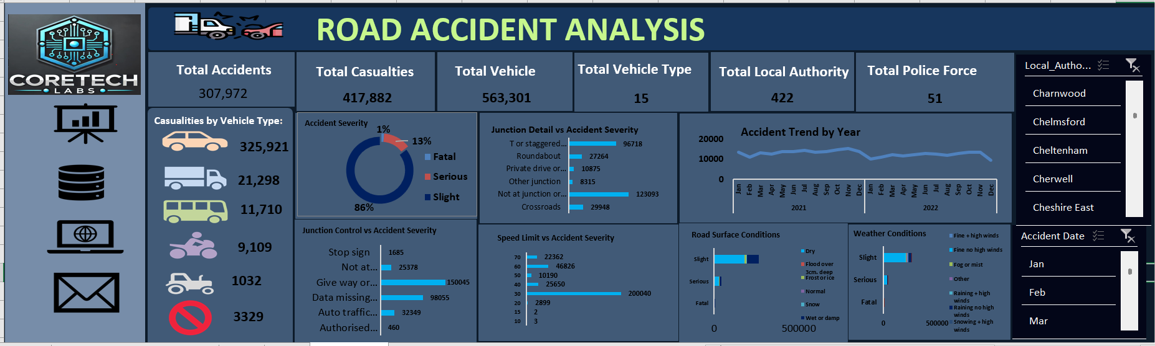
DASHBOARD

